Slide 1



ROCKBUSTER
Online Video Rental Service
Launch Strategy
ROCKBUSTER
Luis Carlos Dunning
January 2025
Notes:
To change the image on this slide, select the picture and delete it. Then click the Pictures icon in the placeholder to insert your own image.

Slide 2

Analysis Objectives
Rockbuster Stealth LLC is a global movie rental company facing stiff competition from streaming services.
To be at the forefront of new trends and be competitive the company is planning to launch an online video rental service with its existing movie licenses.
This Data Analysis is intended to provide data-driven insights to key questions:
Which movies contributed the most/least to revenue gain?
What was the average rental duration for all videos?
Which countries are Rockbuster customers based in?
Where are customers with a high lifetime value based?
Do sales figures vary between geographic regions?

Slide 3




Approach and strategy
We analyzed customer data, film preferences, rental patterns, and geographical information to derive meaningful insights. The results are presented using user-friendly visualization to ensure clarity and ease of understanding.

Slide 4

Data Statistics Overview
Customer table
599 Total Customers
326 Customers in Store 1
273 Customers in Store 2
584 Active Customers
91 Inactive Customers
Film table
Total Films: 1,000 films in the dataset.
Release Year: All films are from 2006
Rental Duration: Minimum: 3 days
Maximum: 7 days
Average: 4,9 days
Rental Rates: Minimum: $0,99
Maximum: $4,99
Average: $2,98
Film Lengh: Shortest: 46 minutes
Longest: 185 minutes
Average : 115 minutes
Replacement Cost: Minimum: $9.99
Maximum: $29.99
Average:$19.98
The majority of customers are active 584 out of 599
The average rental rate $2,98 suggests a mid-range pricing.

Slide 5

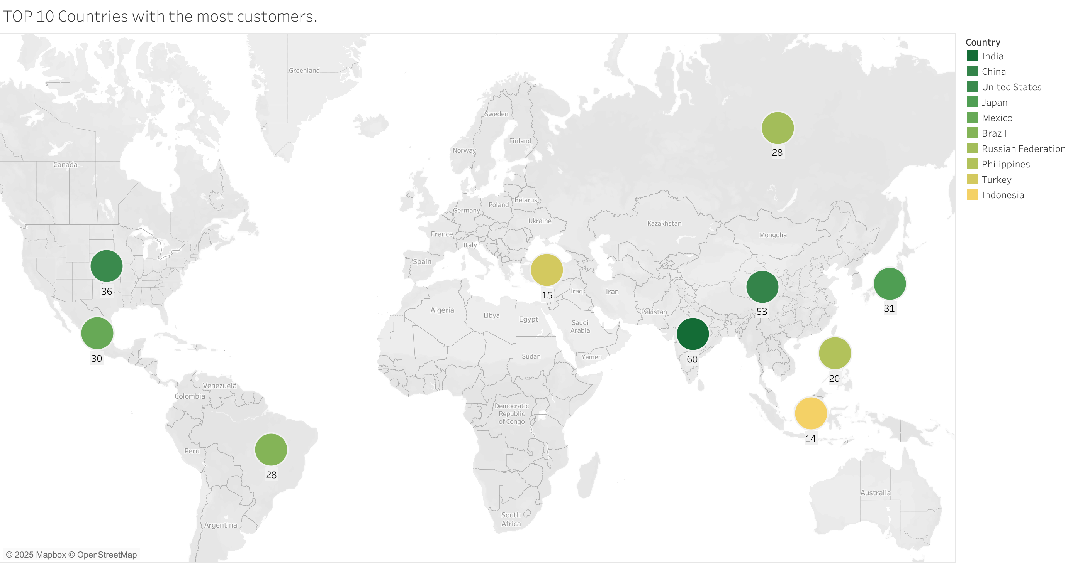
Which countries are Rockbuster customers based in?
Rockbuster customers are based in 108 countries around the world.
The 10 countries with the most customers based are:
Top cities that fall within the top countries:
India with 60 customer
China with 53 customer.
United States with 36 customer.
Japan with 31 customer.
Mexico with 30 customer.
Brazil with 30 customer.
Russia with 28 customer.
Philippines with 20 customer.
Turkey with 15 customer.
Indonesia with 14 customer.
Ambattur.
Shanwei.
Citrus Heights.
Iwaki.
Acua.
So Leopoldo.
Teboksary.
Talavera.
Batman.
Cianjur.
Tableau link: https://tinyurl.com/3r5jby52

Slide 6

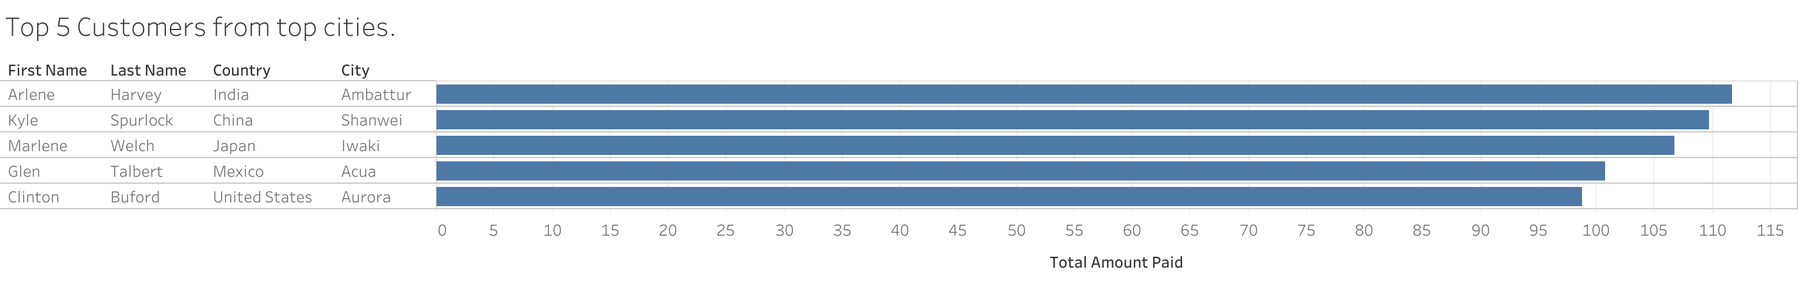
Loyalty Reward Customer Program
We based our selection of our top 5 customers from our top cities based on the amount paid by them.
Tableau link: https://tinyurl.com/2pfhvp5m

Slide 7

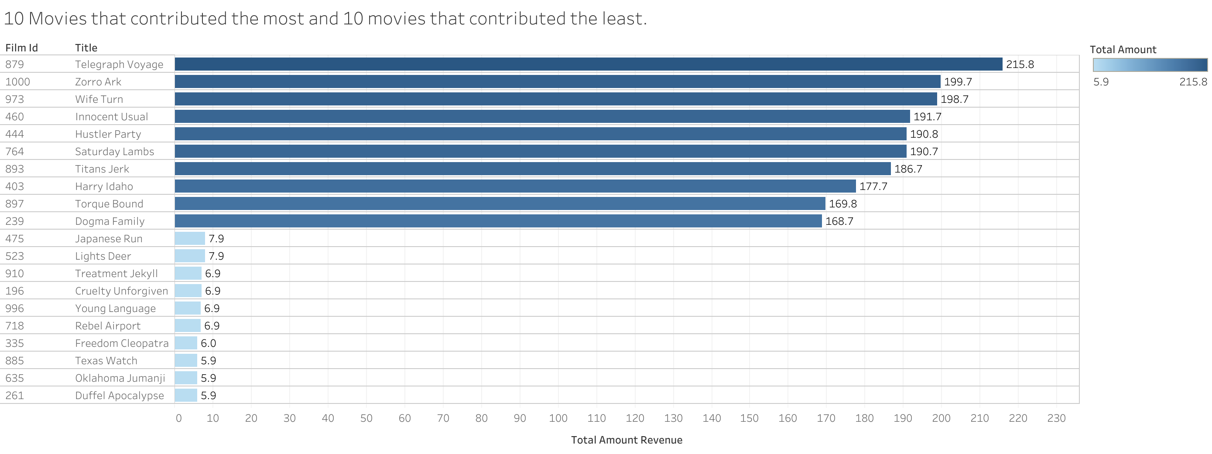

Revenue records across existing movie license.
Understanding customer behavior and revenue patterns through data, we can ensure that the operation gets off to a solid start.
Tableau link: https://tinyurl.com/yzfppvnk

Slide 8

The average rental duration and rental rate.
3 days
4,9 days
7 days
On average, movies have been rented for 4.9 days and with an average rent of $2.98.
Minimum On average Maximum
$0.99
$2.98
$4.99

Slide 9

Recommendations
Focus marketing efforts on high-revenue generating movies, tailor rental and duration to match customers preferences
Allocate marketing resources to high-revenue generation regions to unlock their potential like India, China, United States, Mexico, Japan, Brasil.
Tailor Promotional campaigns to region with high-value customers.

Slide 10


Questions & Feedback
RB
RockBuster
Thank you very much for your attention.
For further questions and comments please contact me on
luis.dunning@rockbuster.com

